Slide 1
Kickstarter Success Predictor
Omar Qusous

Slide 2

What can you do to increase the project’s success?

Slide 3
Data Source
https://webrobots.io/kickstarter-datasets/
Total of 9338 points. Aim to keep 5000 or more (duplicates, Nans, etc…)

Slide 4
Data Source 2
Key:
All NAN:
Repeated information:
Data leakage:
Not useful (logic):
Feature Selection:
['backers_count', 'blurb', 'category', 'converted_pledged_amount', 'country', 'created_at', 'creator', 'currency', 'currency_symbol', 'currency_trailing_code', 'current_currency', 'deadline', ‘'disable_communication', 'friends', 'fx_rate', 'goal', 'id', 'is_backing', 'is_starrable', 'is_starred', 'launched_at', 'location', 'name', 'permissions', 'photo', 'pledged', 'profile', 'slug', 'source_url', 'spotlight', 'staff_pick', 'state', 'state_changed_at', 'static_usd_rate', 'urls', 'usd_pledged', 'usd_type'])
Final Features:
category: Film, Music, Fashion etc..
location: country and state converted to continents to balance data
created_at: data of starting the campaign
deadline: deadline set for achieving the desired amount of money
name: projects name
staff_pick: projects highlighted on homepage
goal: desired amount of money to succeed
Notes:
All NAN: ‘'disable_communication', 'friends'
Repeated information: ‘static_usd_rate', 'blurb'
Data leakage: 'spotlight', ‘baclers’
Not useful (logic): 'photo', 'currency_symbol'

Slide 5
EDA and Feature Engineering 1
Continuous Data:
df['time_allowed'] = df['deadline']-df['created_at'] # in days
outliers = df[(df['time_allowed'] > 5000) & (df['goal'] > 2e6)]
Log(df['time_allowed']) and Log(df['goal'])
Categorical Data:
Converted to dummies
df[['category', 'staff_pick', 'country']]
Total of 168 columns in X

Slide 6
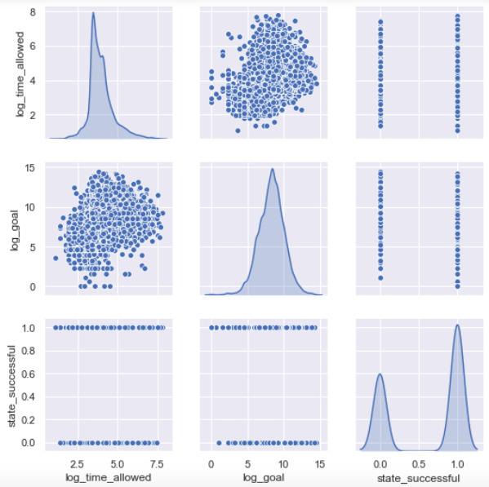
EDA and Feature Engineering 2

Slide 7
Target
Target:
‘State’ : successful, failed, suspended, live, cancelled
Eliminated live, cancelled and suspended
‘Binary distribution (1: success, 0: failure)

Slide 8
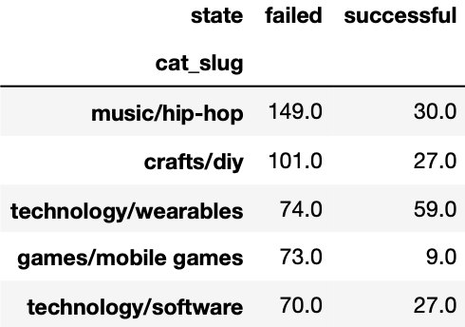
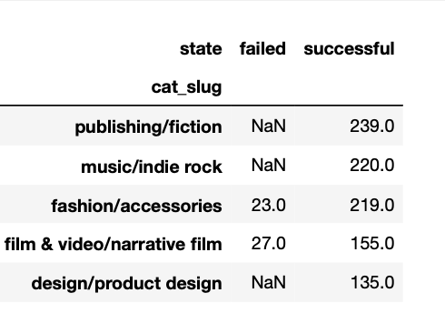
Quick Interesting Stats 1
Most successful and unsuccessful project categories

Slide 9
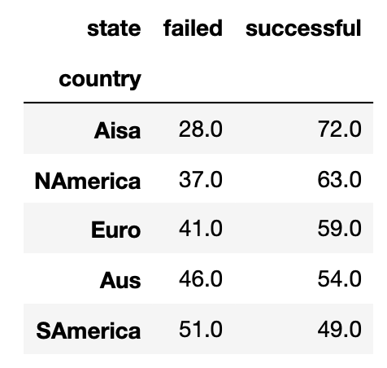
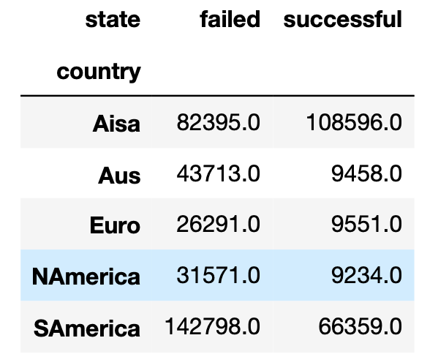
Quick Interesting Stats 2
Percentage Success/Failure by Continent
Average ‘Goal’ for successful and failed projects

Slide 10
Models 1
Ran Three Models:
Random Forest with hyperparameter tuning using iterations and AUC plots
Logistic Regression with hyperparameter tuning in solver, C and penalty
XGBoost with Gridsearch

Slide 11
Models 2
ADD AUC and FOREST PLOTS

Slide 12
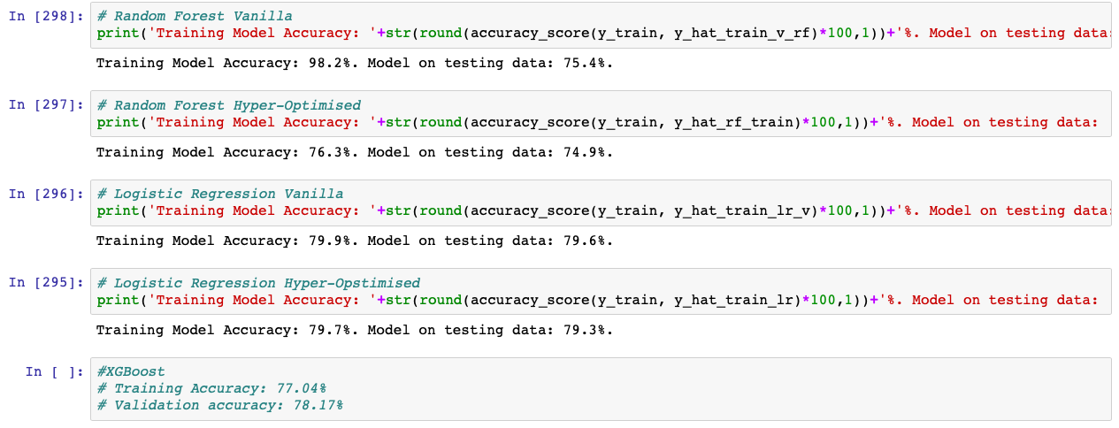
Models 3
Baseline accuracy model DummyClassifier(strategy='most_frequent') produced 62.6% accuracy

